Slide 1
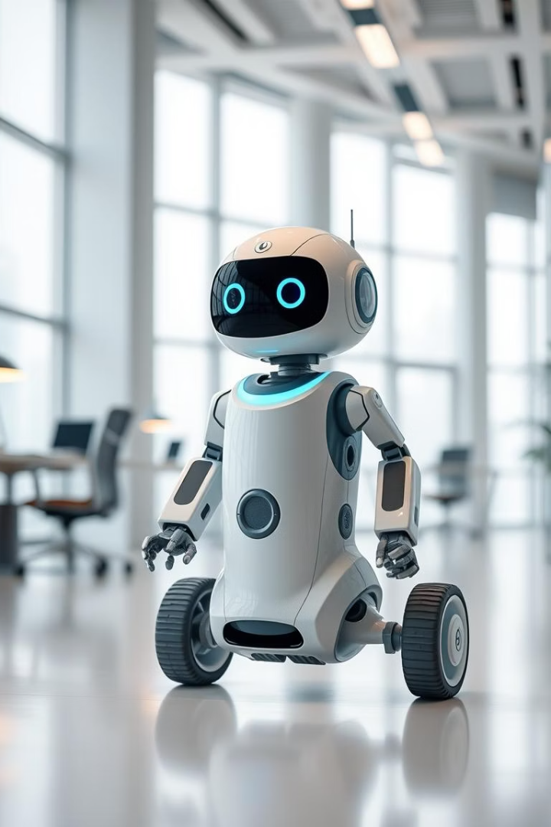
Autonomous Navigation in Indoor Environments

Slide 2
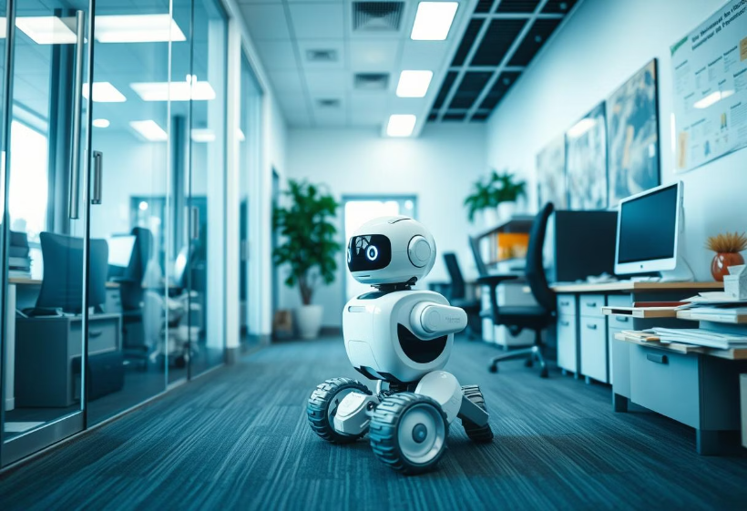
Introduction
Autonomous robots are revolutionizing industries by enhancing efficiency across diverse sectors, yet navigating complex indoor environments remains a significant challenge. This project addresses these indoor navigation hurdles by developing a robust vision-based system. The goal is to empower robots to move autonomously through homes, offices, and warehouses, overcoming obstacles like furniture with precision. By leveraging advanced AI and computer vision technologies, the system aims to provide a reliable, cost-effective solution, paving the way for safer and smarter robotic applications in everyday life
.

Slide 3

Objectives
1
Object Detection
2
Mapping
3
Path Planning
Accurately identify and classify objects within the indoor environment using advanced computer vision techniques. This involves detecting diverse obstacles and landmarks in real time to support safe navigation and interaction by the autonomous robot.
Create a detailed and up-to-date map of the indoor environment by integrating sensor data and visual information. This map will enable the robot to understand spatial layouts and dynamically update its environment representation as it navigates.
Design an optimal and efficient path for autonomous navigation that considers obstacles, robot dynamics, and environmental changes. The goal is to generate safe, collision-free trajectories that allow the robot to reach its destination with minimal time and energy expenditure.

Slide 4
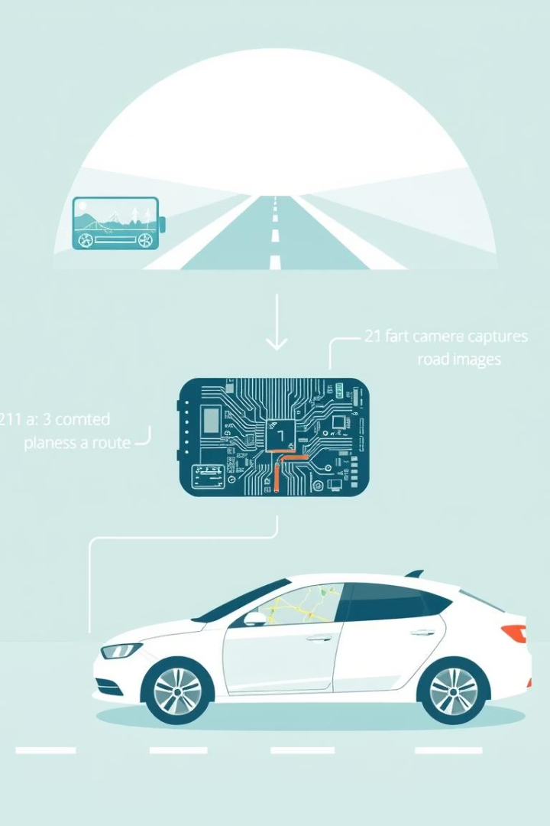




Methodology
Dataset Upload
Upload the data of images of the environment to the system.
Preprocessing
Enhance image quality for better object detection.
YOLO/ORB Usage
Utilize YOLO for object detection and ORB for feature extraction.
Path Design
Plan the most efficient path to avoid obstacles.

Slide 5





Tools and Technologies
Python
Google Colab
OpenCV
YOLOv3
Programming language used for development.
Cloud platform for running experiments.
Library for computer vision tasks.
Object detection framework.

Slide 6
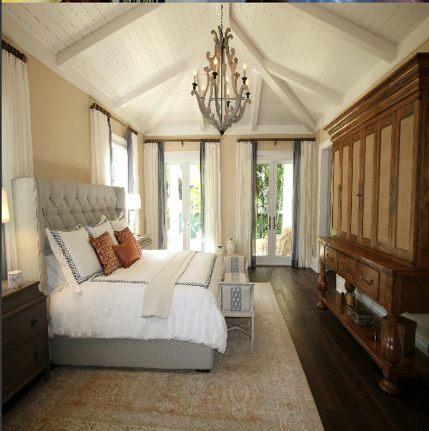
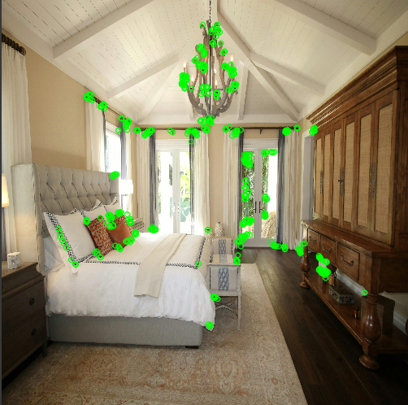
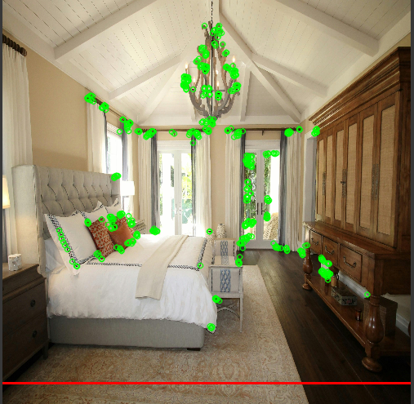
Results
Keypoints
Detected Objects
Paths
Identified key features that are critical for accurate mapping and localization of the robot within the indoor environment. These keypoints help in recognizing distinct landmarks and assist the system in real-time position tracking, improving navigation reliability.
Generated efficient and collision-free routes that allow the robot to navigate complex indoor spaces smoothly. The path planning algorithm dynamically adjusts to environmental changes, ensuring optimal travel time and energy consumption.
Generated efficient and collision-free routes that allow the robot to navigate complex indoor spaces smoothly. The path planning algorithm dynamically adjusts to environmental changes, ensuring optimal travel time and energy consumption.

Slide 7
Challenges and Solutions
Path Overlap
Challenge: Initial paths generated by the navigation system contained multiple overlapping segments, which led to inefficient movements and increased navigation time for the robot.
Solution: We implemented advanced path optimization algorithms that analyze and eliminate redundant overlapping segments. This not only ensures smoother navigation but also improves the overall efficiency, reducing time and energy consumption during movement.
Dynamic Floor Adjustment
Challenge: The robot encountered difficulties when traversing uneven or changing floor surfaces that could compromise stability and navigation accuracy.
Solution: To address this, we integrated sensor fusion techniques combining data from multiple sensors to detect floor variations in real-time. This allows the robot to dynamically adjust its height and balance, maintaining stability and safe navigation across diverse indoor environments.

Slide 8

Conclusion
Summary
Achievements
Future Work
Successfully developed a vision-based autonomous navigation system.
Demonstrated object detection, mapping, and path planning.
Improve robustness, explore advanced sensors, and consider real-world deployment.

